Slide 1
DIGITAL PORTFOLIO
L.ANBARSAN
32124U18003
B.SC COMPUTER SCIENCE
THIRUVALLUR UNIVERSITY

Slide 2
FUTURE DIGITAL MARKETING

Slide 3
AGENDA
1Portfolio design and Layout
2.Tools and Technologies
3.Problem Statement
4.Features and Functionality
5.Project Overview
6.Results and Screenshots
7.Conclusion8.GithubLink

Slide 4
PROBLEM STATEMENT
Current digital resumes and static profiles often fail to effectively showcase the dynamic skills, projects, and latest trends crucial in the fast-evolving field of digital marketing. Students and professionals lack a structured, interactive online platform that not only highlights their achievements but also demonstrates their understanding and application of emerging digital marketing technologies and strategies.

Slide 5
PROJECT OVERVIEW
This project involves creating an interactive, user-friendly digital portfolio website using HTML, CSS, and JavaScript to showcase a professional or student’s skills, trending knowledge, and projects in digital marketing. The website is designed as a clean, modern single-page application with tab-based navigation, allowing easy access to key sections: About, Trending Skills, Projects, and Contact.

Slide 6
TOOLS AND TECHNIQUES
HTML, CSS, JavaScript → for creating the portfolio website
Code pen for coding GitHub for hosting & sharing the projects

Slide 7
WHO ARE THE END USERS
Students and Professionals in Digital Marketing – Those seeking to showcase their skills, projects, and knowledge of future digital marketing trends as part of their personal branding and career advancement. Job Recruiters and Hiring Managers – Individuals or companies looking to evaluate candidates’ digital marketing expertise and experience through an interactive, easy-to-navigate online portfolio rather than traditional resumes. Freelancers and Independent Marketers – Marketing professionals who need a platform to promote their services, demonstrate past work and successes, and connect with potential clients

Slide 8
Features and functionality
Interactive Tab Navigation: Users can switch seamlessly between sections like About, Trending Skills, Projects, and Contact through clickable tabs, enhancing user experience. About Section: Provides a concise personal introduction highlighting focus areas and career goals relevant to future digital marketing trends. Trending Skills Showcase: Lists up-to-date digital marketing skills such as AI automation, social commerce, AR/VR, predictive analytics, and data privacy strategie.

Slide 9
DESIGN AND LAYOUT
Header: A prominent header area with the portfolio title and a brief tagline or description that introduces the portfolio’s focus on the future of digital marketing. Navigation Bar: A horizontal navigation bar below the header with clearly labeled tabs (About, Trending Skills, Projects, Contact). The navigation uses a button style that highlights the active tab, making it visually clear and easy to use. Content Sections: Each section (About, Trending Skills, Projects, Contact) is distinct and well-padded with whitespace for readability. The About section uses a simple paragraph to introduce the indioduce the individual.

Slide 10
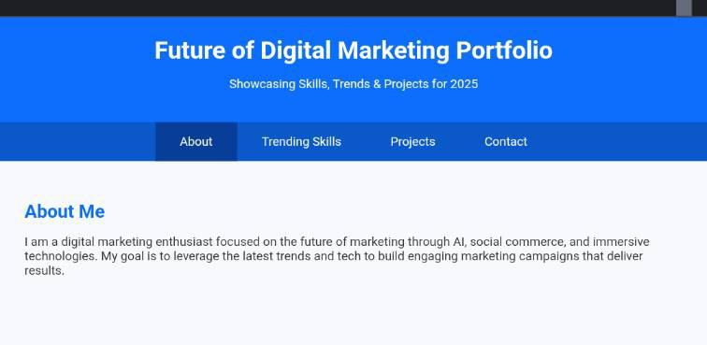
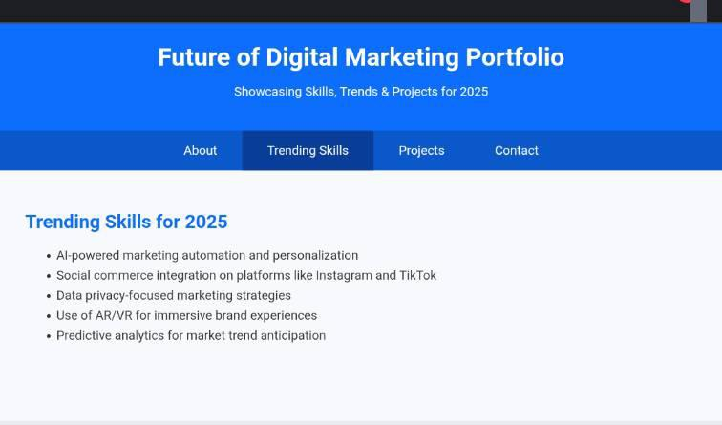
RESULT AND SCREENSHOT

Slide 11
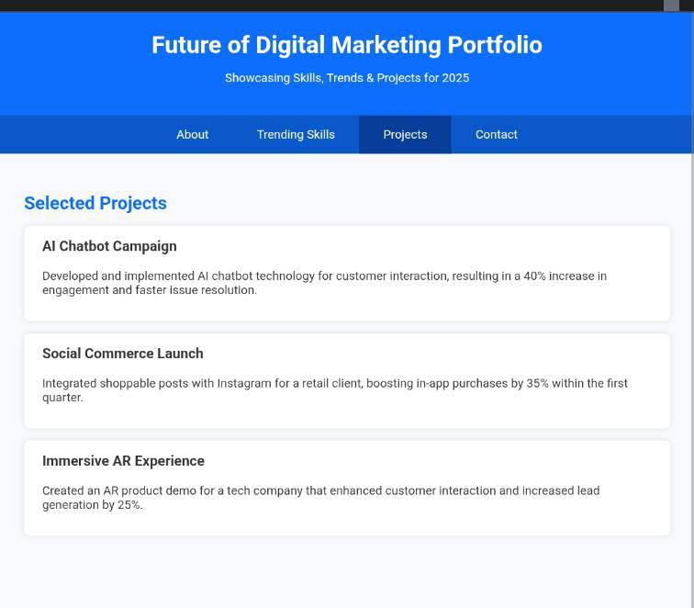
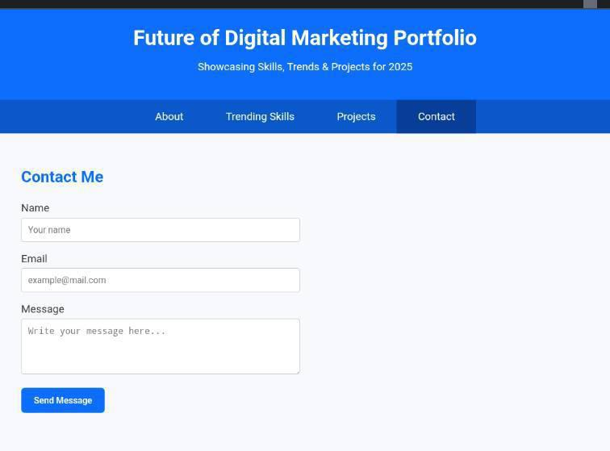
RESULT AND SCREENSHOT

Slide 12
Conclusion
This digital marketing portfolio website serves as an essential modern tool to effectively showcase skills, projects, and expertise in a visually engaging and interactive way. Unlike a traditional resume, the portfolio provides tangible evidence of practical abilities and achievements, demonstrating knowledge of future-focused digital marketing trends such as AI automation, social commerce, and immersive experiences. By combining clean design, responsive layout, and seamless interactivity, this portfolio enables professionals and students to communicate their value clearly and professionally to recruiters, clients, and collaborators. It builds credibility, fosters trust, and enhances personal branding in a competitive industry.

